Slide 1

Dashboard Design

Slide 2
Objective
The objective of this dashboard is to provide business stakeholders with a comprehensive and interactive view of the company’s sales and profitability performance. The dashboard enables users to:
Monitor key performance indicators (KPIs) such as Sales, Profit, Orders, and Average Order Value.
Analyze trends over time using time-series visualizations.
Identify top-performing regions, products, and customer segments.
Gain insights for data-driven decision-making through dynamic filtering and drill-downs.

Slide 3
Data Source
Dataset Name: Superstore.csv
Source: Kaggle
Description: The dataset includes sales transaction records from a retail chain, covering information such as:
Order Date
Sales and Profit
Product Categories and Sub-Categories
Customer Segments
Regions and States

Slide 4
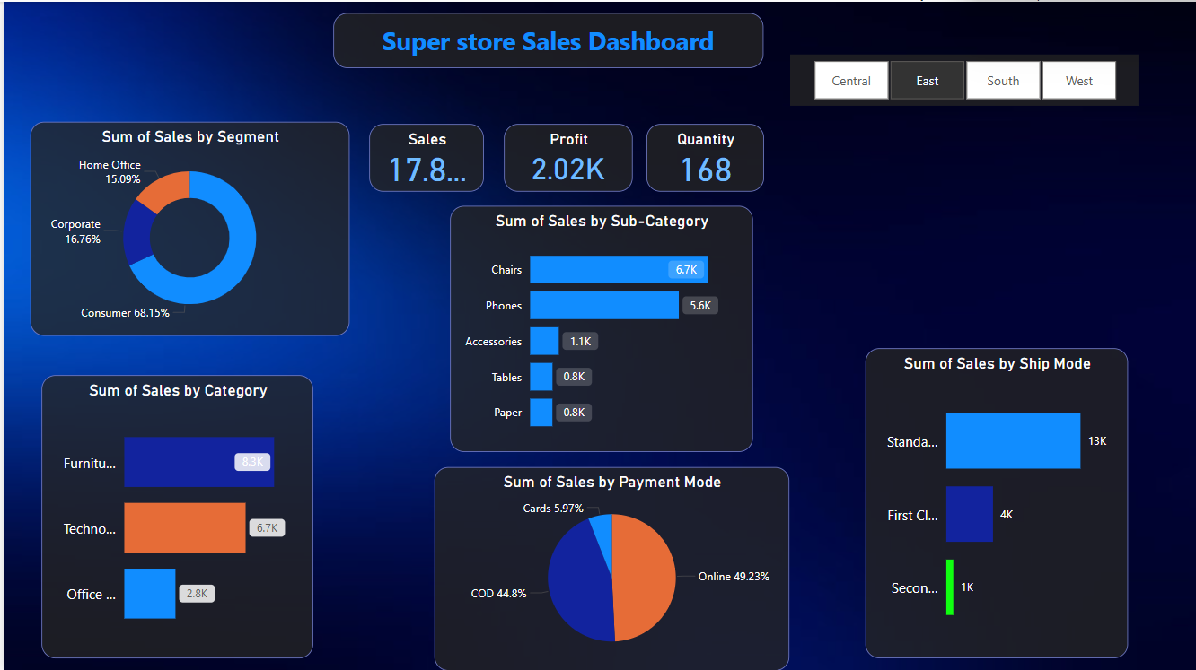
Screenshot

Slide 5
Conclusion
The interactive dashboard offers a clear and intuitive view of the company’s sales and profitability metrics, helping stakeholders monitor business performance effectively. Through dynamic filters, time-series trends, and categorical breakdowns, the dashboard reveals valuable insights.
By combining KPIs, visual storytelling, and interactivity, the dashboard equips decision-makers with actionable insights to optimize sales strategies, improve customer targeting, and enhance overall business growth.

